Slide 1
MODFLOW 6 Overview
Advanced Modeling of Groundwater Flow (GW3099)
Lincoln, NE
October 22-26, 2018

Slide 2
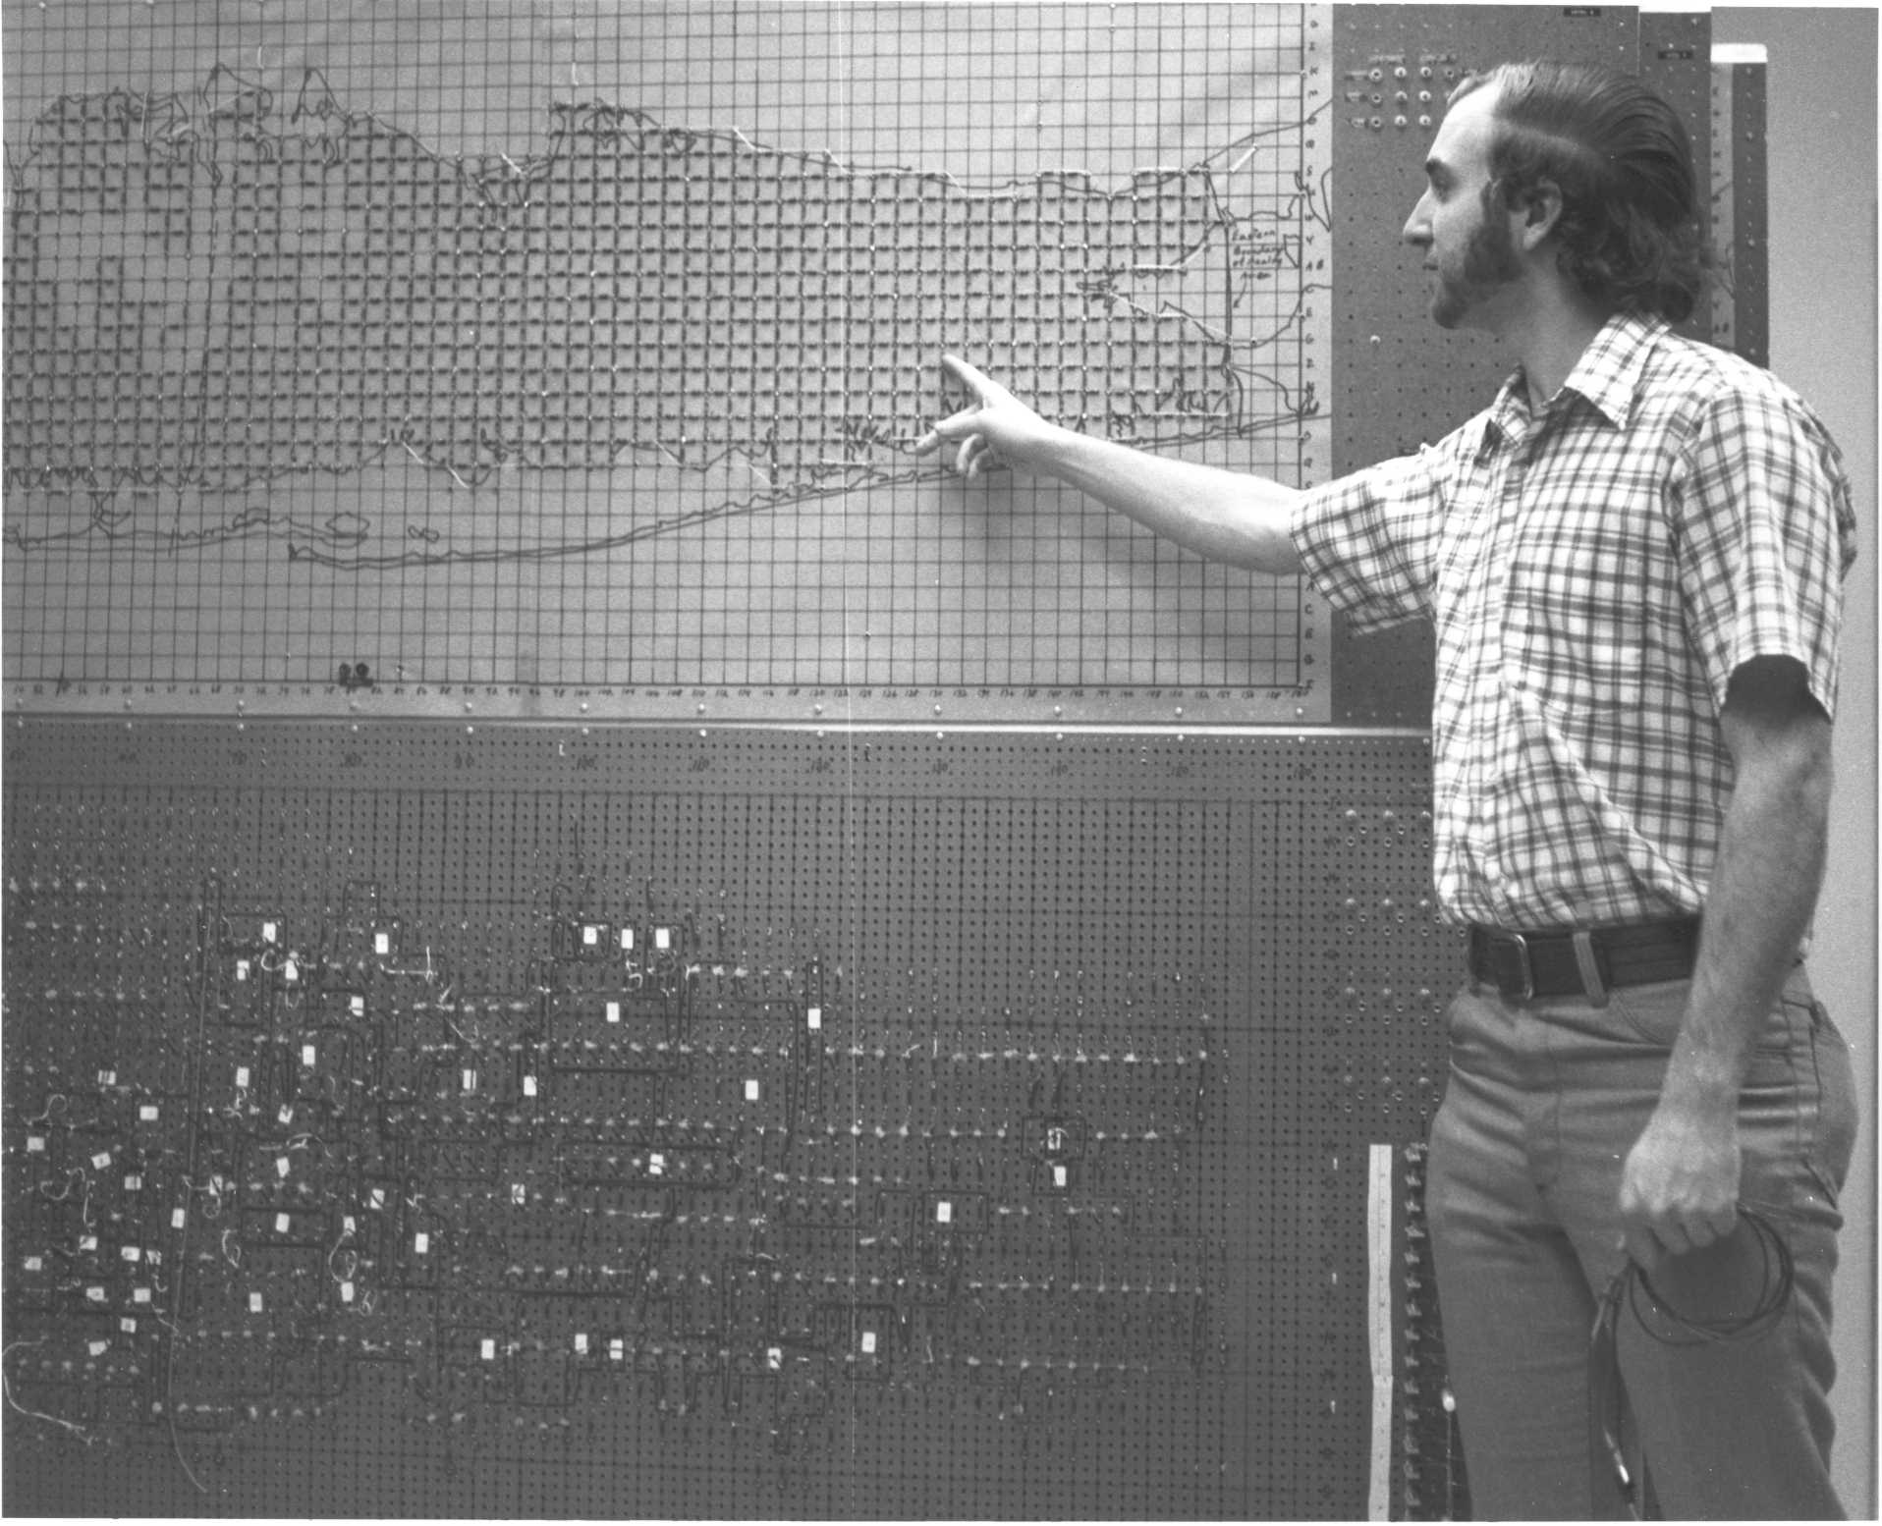
background

Slide 3
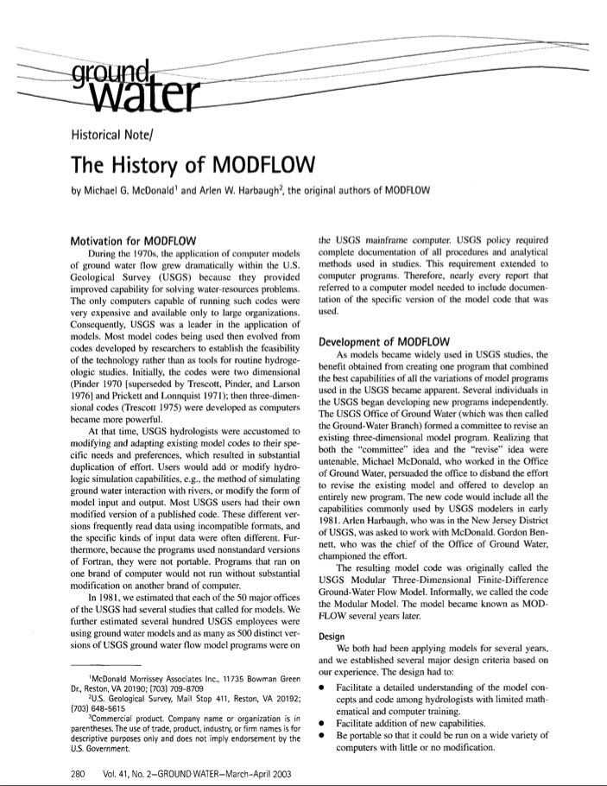
History
1970’s proliferation of groundwater models led to numerous diverging codes within the USGS
The best capabilities were combined to form MODFLOW

Slide 4
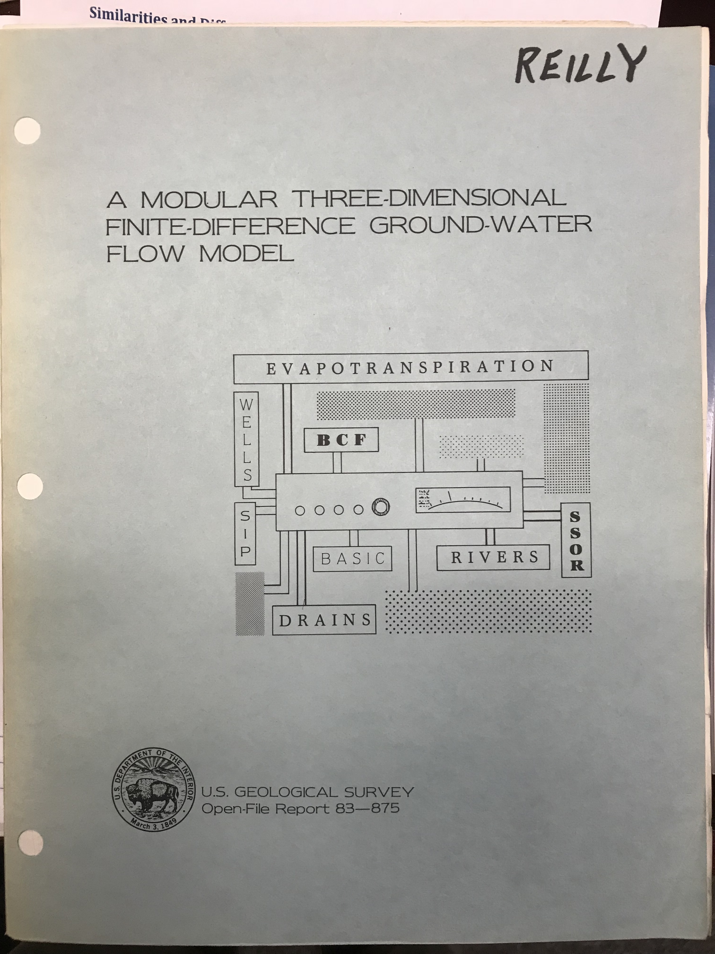
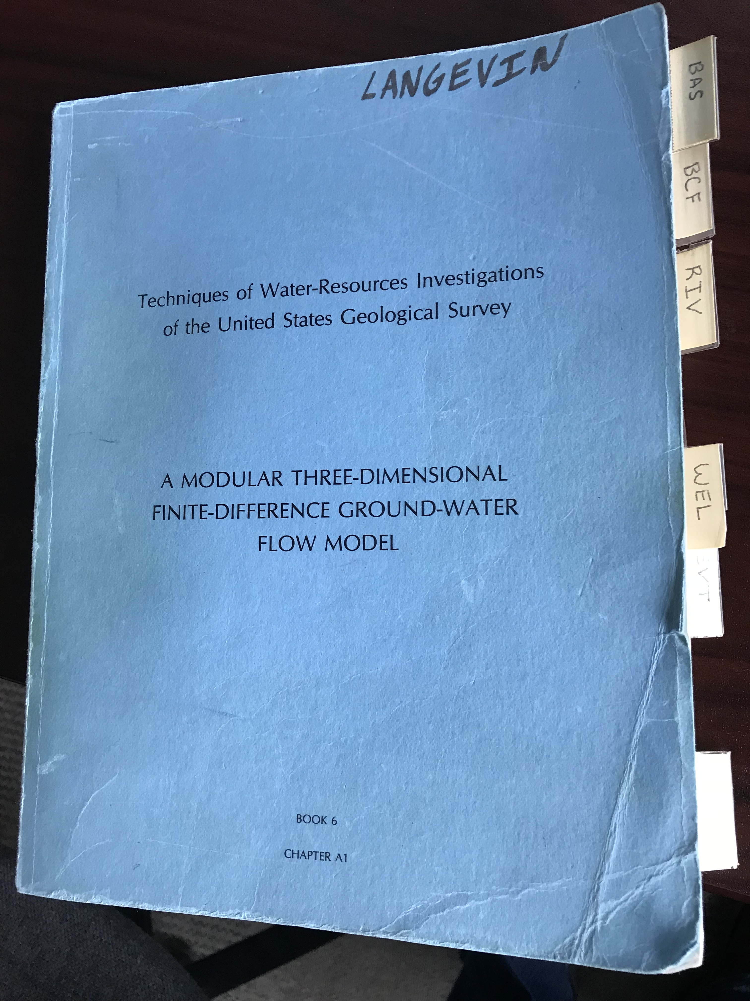
MODFLOW 1984 and 1988

Slide 5

MODFLOW Development and use in the USGS
Office of
Groundwater
National Research
Program
Water Science
Centers

Slide 6



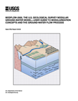
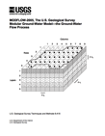
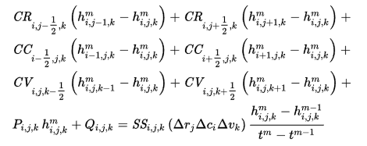
MODFLOW Core Versions
1984
1988
1996
2000
2005
What do we mean by “core” version?
Production version
Stable
Well documented
Well tested
Long-term funding
Starting point for new developments
Notes:
Production codes
Well tested
USGS headquarters supported

Slide 7

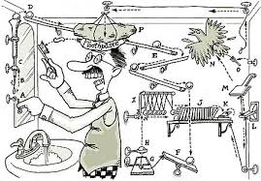
Philosophy of a “Production Code”
Easy to understand
Finite difference
Well documented
Extensible
Modular design
Portable
use standard FORTRAN
Efficient (memory and speed)
Judicious incorporation of new capabilities
Exclude functionality that can be done outside

Slide 8
MODFLOW Philosophy
Maintain production version
Keep MODFLOW lean!
Anything that can be done outside of MODFLOW should be done outside MODFLOW (e.g., no dates and times)
You can’t accommodate everyone
Encourage others to enhance MODFLOW
Release new capabilities in different versions
No dependencies
Periodically update production version with proven advancements

Slide 9
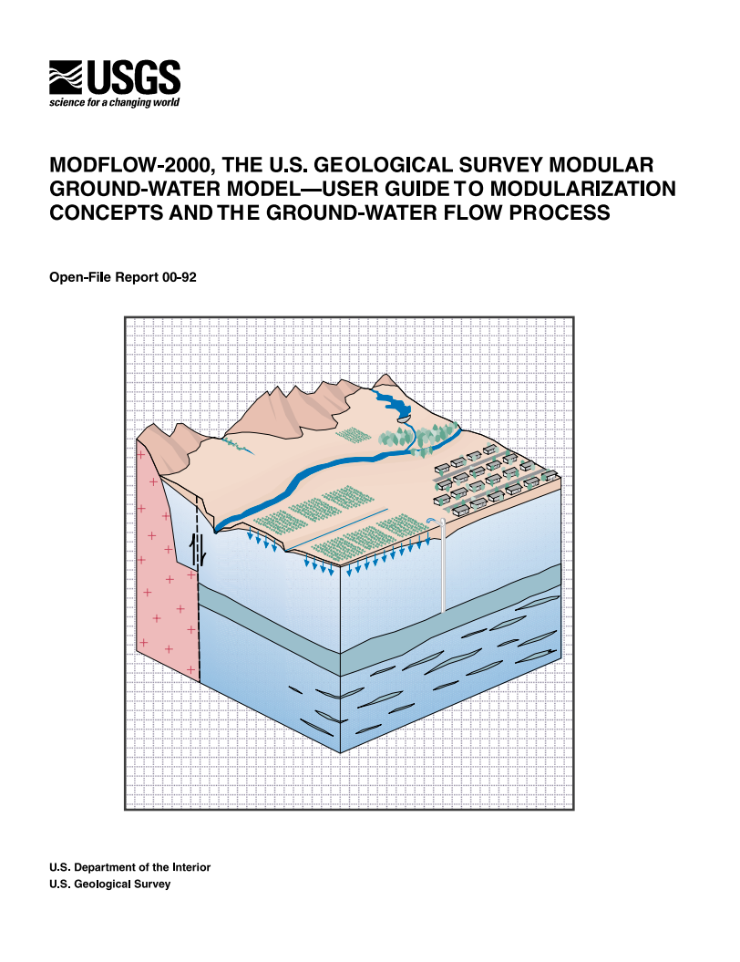
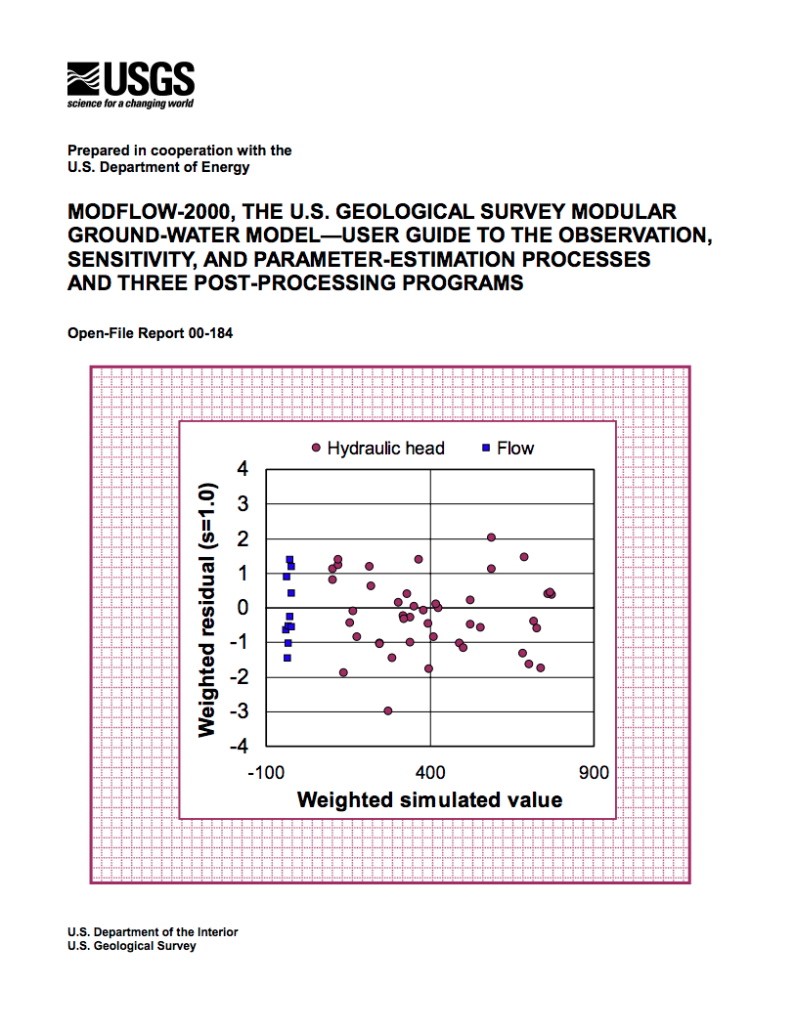
MODFLOW-2000 Example
New processes added to MODFLOW
Observations (OBS)
Sensitivity (SEN)
Parameter Estimation (PES)
Resulted in thousands of lines of new code
Code become very complicated
Generalized parameter estimation programs became the norm (e.g. PEST)

Slide 10
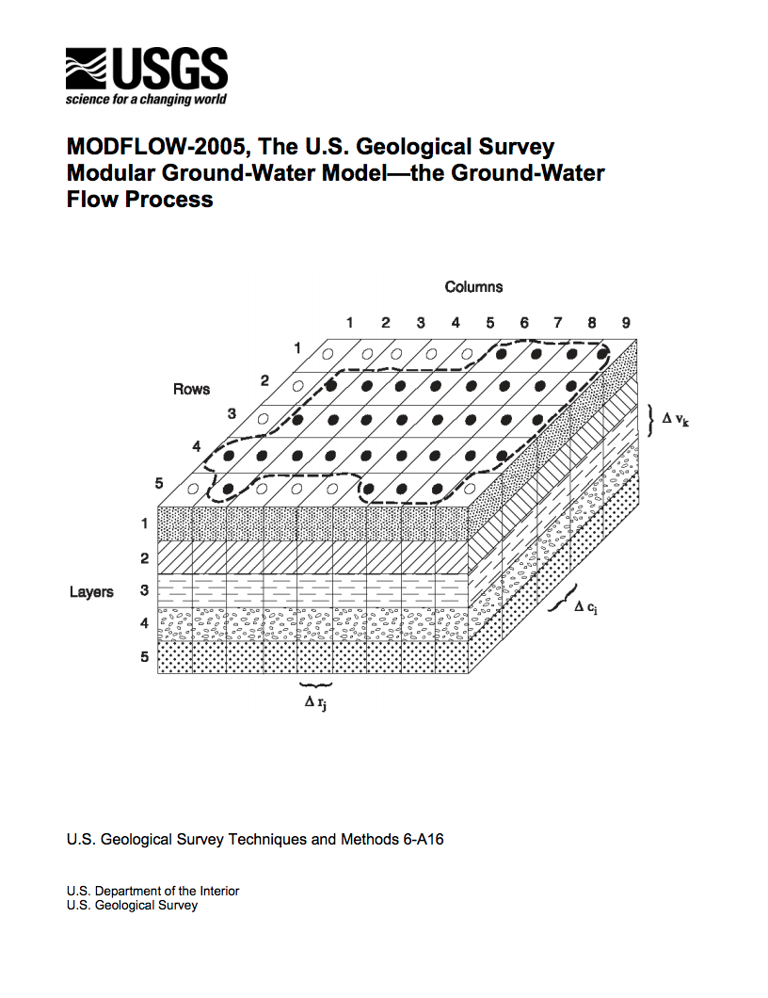
MODFLOW-2005
Code redesigned to improve memory handling
Removed SEN and PES

Slide 11

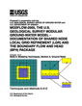



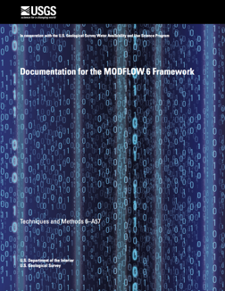
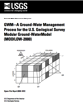

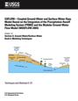

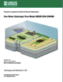


USGS MODFLOW Versions (since 2005)
2015
2005
2010

Slide 12
Common Themes
Coupled models and packages
Pipe flow (CFP, USG)
Surface water flow (SFR, LAK, SWR)
Unsaturated flow (VSF, UZF)
Solute transport (GWT)
Variable-density flow and transport (SEAWAT)
Watershed (GSFLOW)
Agricultural demand (OWHM)
Unstructured/asymmetric solvers (NWT, USG, SWR, CFP)
Multiple models and packages
Local grid refinement (MF-LGR)
Multiple packages of the same type (CDSS)

Slide 13
MODFLOW 6

Slide 14
MODFLOW 6 Development
Consolidate popular capabilities from MODFLOW versions (2005, NWT, USG, LGR, …)
Improve solution technique
Modernize code and input structure
Support multi-model simulations
Extend MODFLOW into a hydrologic simulator
New core version
1984
1988
1996
2000
2005
2017
Notes:
MODFLOW 6 will combine the best features of existing versions of MODFLOW and get rid of outdated functionality. Highly coupled and complex systems will be solved with one system of equations making this MODFLOW version much faster than with previous versions of MODFLOW that iteratively solved the flow part, then the other parts, like transport or local grid refinement. This effort intends to modernize MODFLOW’s design to account for 20+ years of improvements in software design and essentially making MODFLOW a more of a hydrologic simulator.

Slide 15
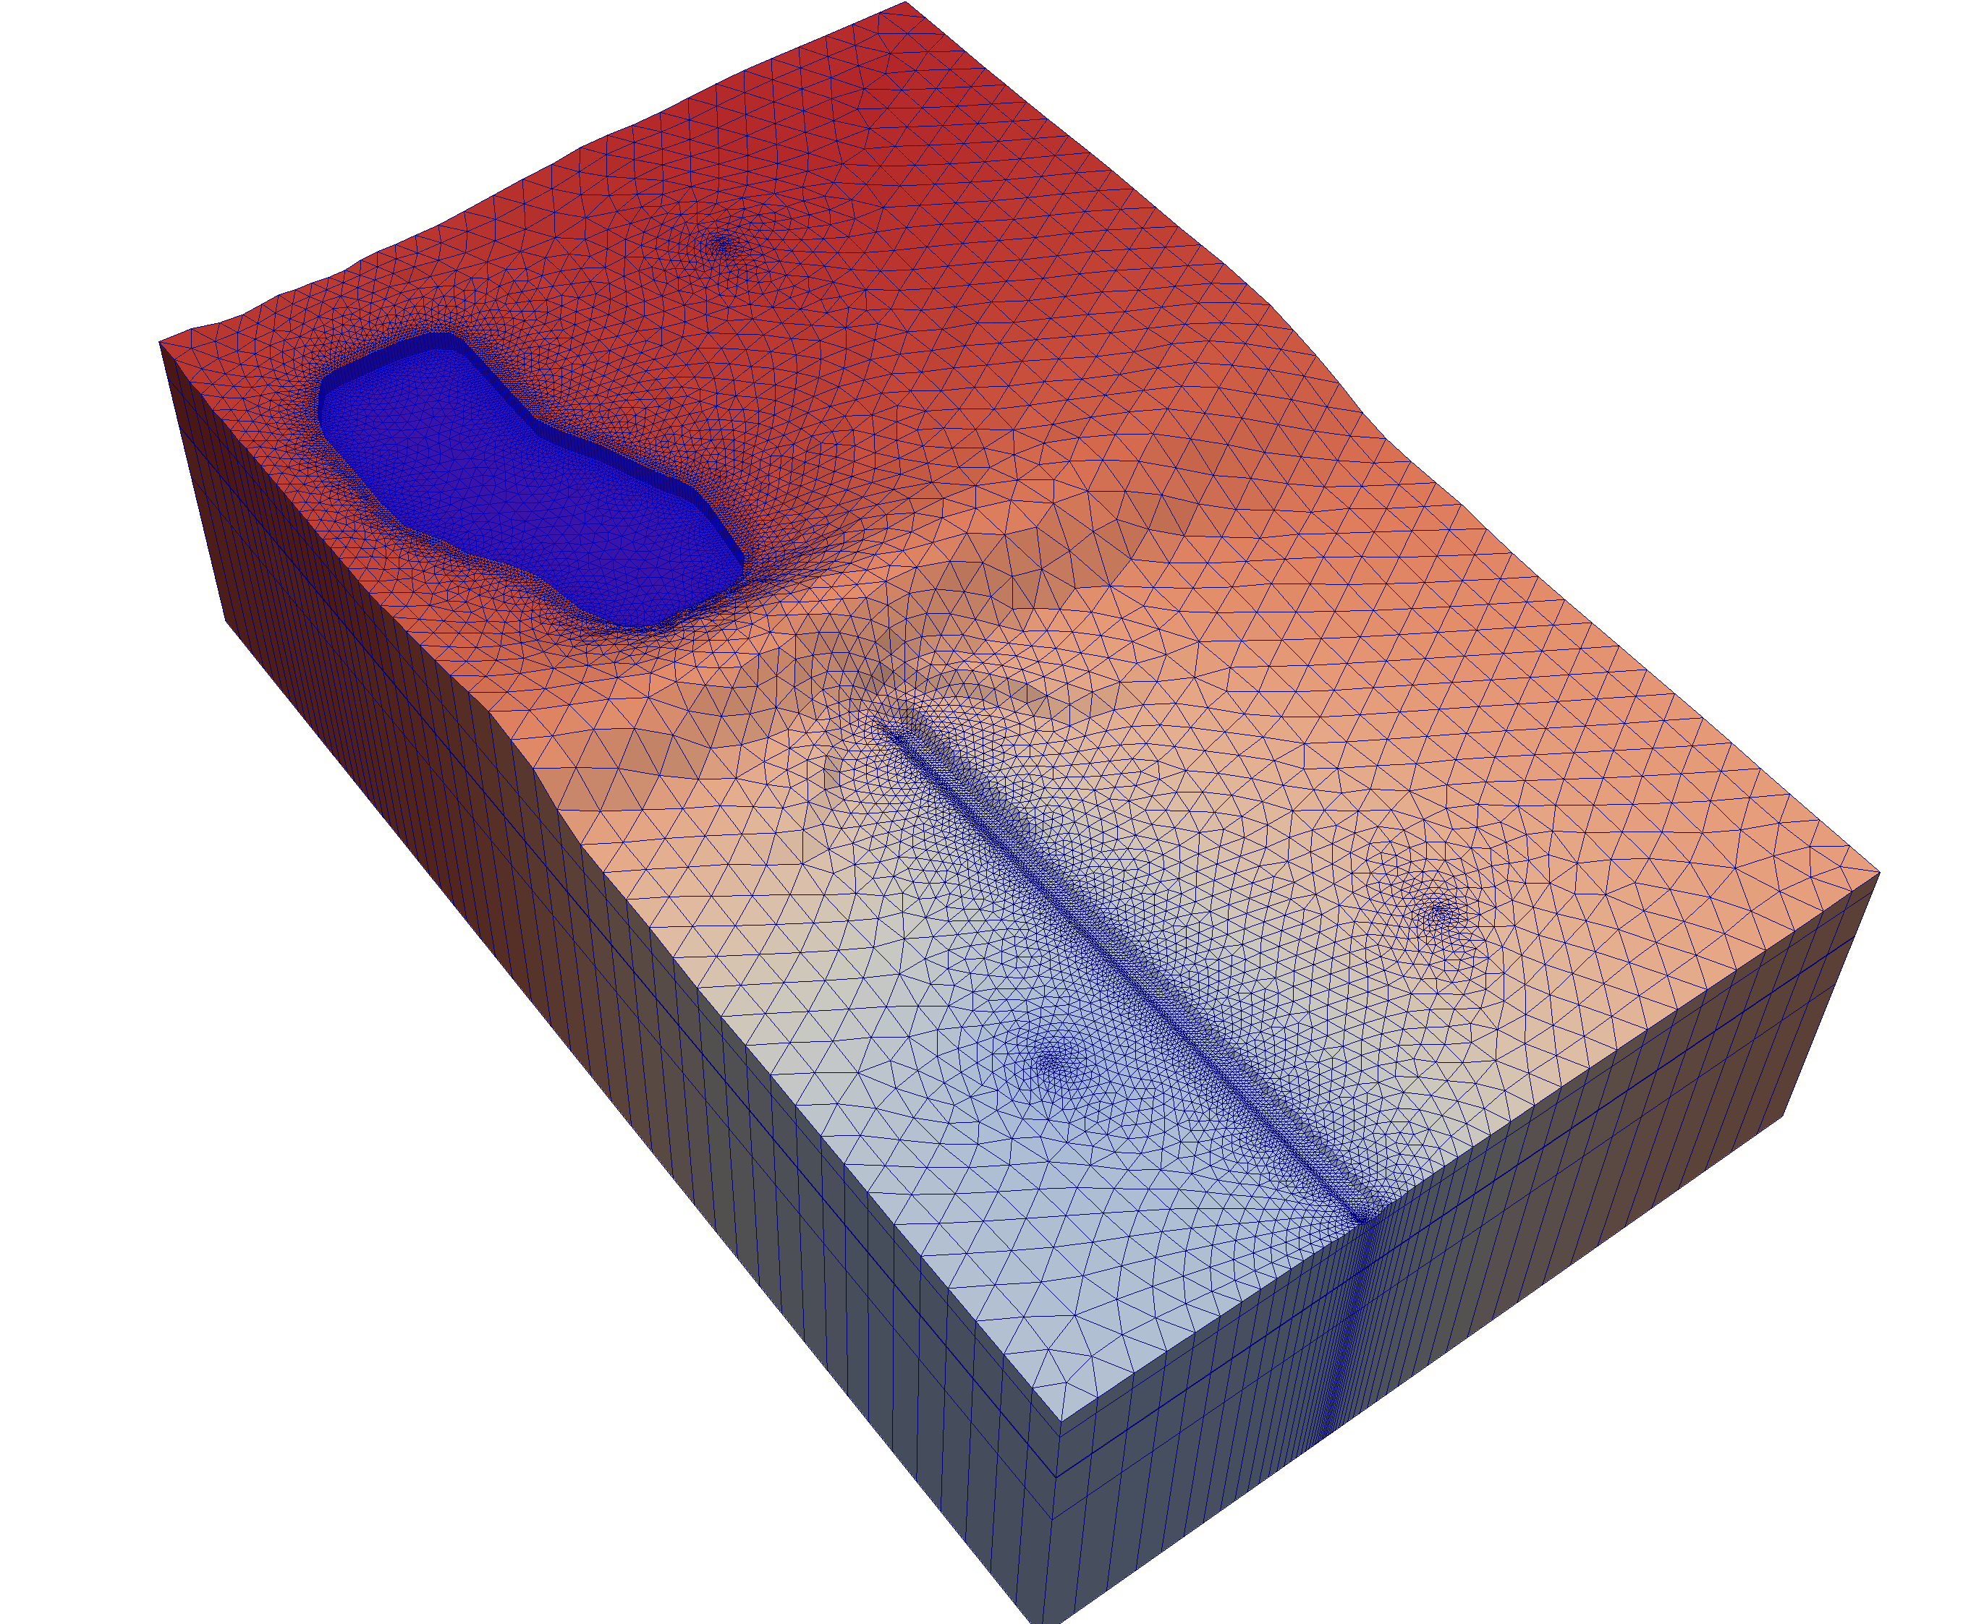

MODFLOW 6
Object oriented
Multiple models
Multiple packages
Control volume finite difference formulation
Regular grids or unstructured grids
Traditional or Newton Raphson formulation
New look and feel
Available now (6.0.3)

Slide 16

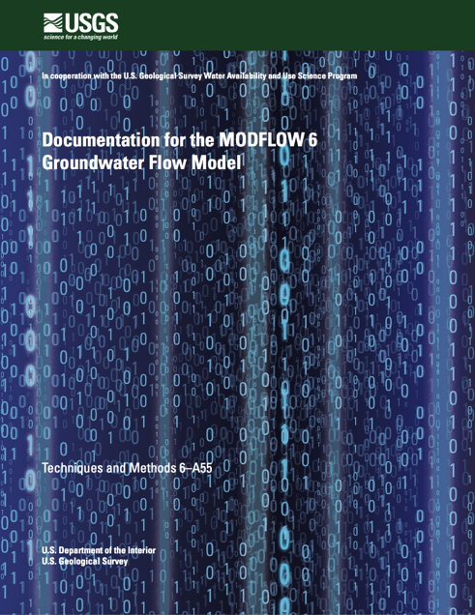
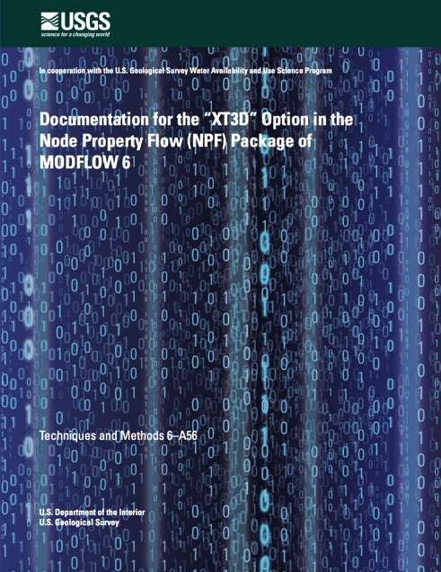
MODFLOW 6 Publications
Hughes, J.D., Langevin, C.D., and Banta, E.R., 2017, Documentation for the MODFLOW 6 framework: U.S. Geological Survey Techniques and Methods, book 6, chap. A57, 40 p., https://doi.org/10.3133/tm6A57.
Langevin, C.D., Hughes, J.D., Banta, E.R., Niswonger, R.G., Panday, Sorab, and Provost, A.M., 2017, Documentation for the MODFLOW 6 Groundwater Flow Model: U.S. Geological Survey Techniques and Methods, book 6, chap. A55, 197 p., https://doi.org/10.3133/tm6A55.
Provost, A.M., Langevin, C.D., and Hughes, J.D., 2017, Documentation for the "XT3D" option in the Node Property Flow (NPF) Package of MODFLOW 6: U.S. Geological Survey Techniques and Methods, book 6, chap. A56, 40 p., https://doi.org/10.3133/tm6A56.

Slide 17
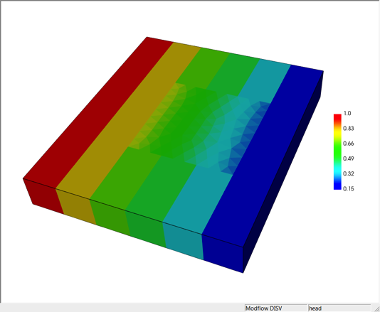
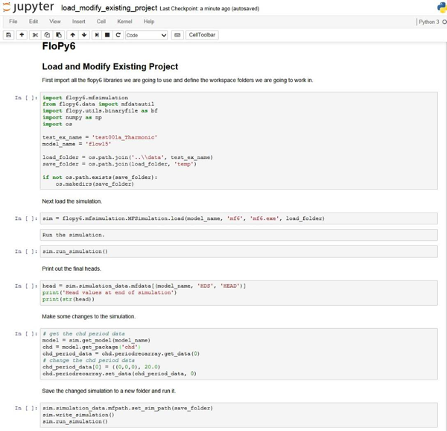
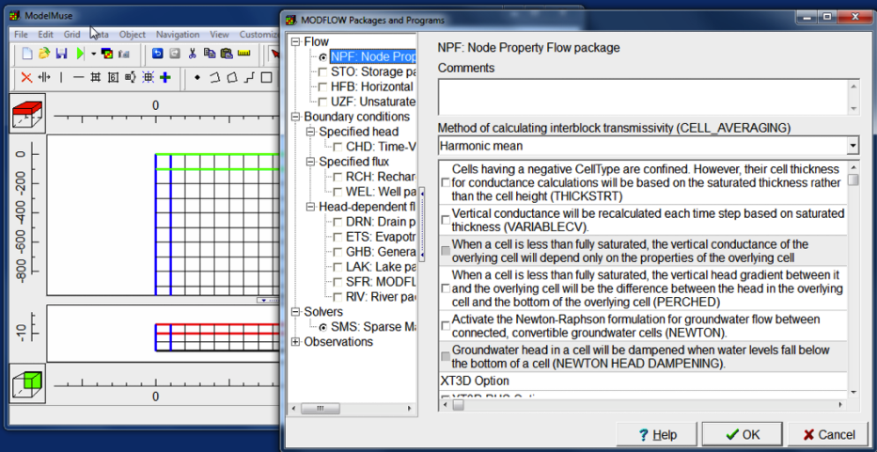
USGS Support Software
MF5TO6
Included with MODFLOW 6
ZONEBUDGET
Included with MODFLOW 6
FLOPY for MODFLOW 6
Available now
MODPATH 7
Available for certain types of grids
MODELVIEWER
Beta available
MODELMUSE (Winston)
Beta version available
Notes:
Chris

Slide 18
MODFLOW 6 FRAMEWORK

Slide 19
Simulation Components
Simulation
Timing Module
Solutions
Models
Exchanges
Utilities
Timing Module
Solution 1
Model 1
Model 2
Model 3
Model 4
Exchange 1
Exchange 2
Exchange 3

Slide 20
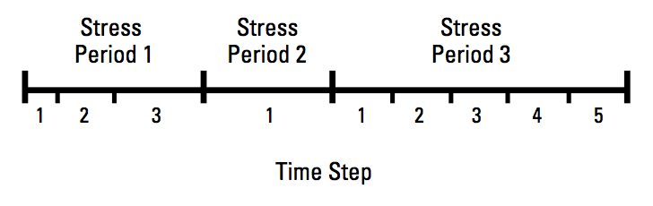
Timing Module
TDIS Package
Uses the MODFLOW concepts of stress periods, time steps
Alternative timing packages may be developed in the future
Timing applies to all models

Slide 21
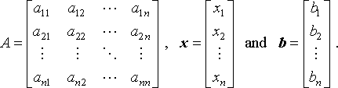
Solutions
Used to solve one or more models and exchanges
The only solution available now is the Iterative Model Solution, or IMS
Unstructured and asymmetric
IMS solves the following nonlinear equation
Ax = b

Slide 22
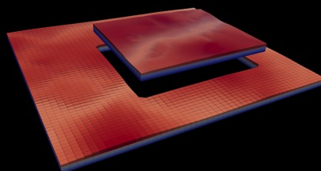
Multi-Model Simulation
MODFLOW 6 foundation allows models to be tightly coupled at the matrix level
Allows local grid refinement (LGR), and other model coupling strategies

Slide 23
LGR Simulation
Simulation
Temporal Discretization
PARENT
C1
C2
GC
Iterative Model Solution

Slide 24
GWF Exchanges
Simulation
Temporal Discretization
PARENT
C1
C2
GC
Iterative Model Solution
PARENT-C1
PARENT-C2
C1-GC

Slide 25
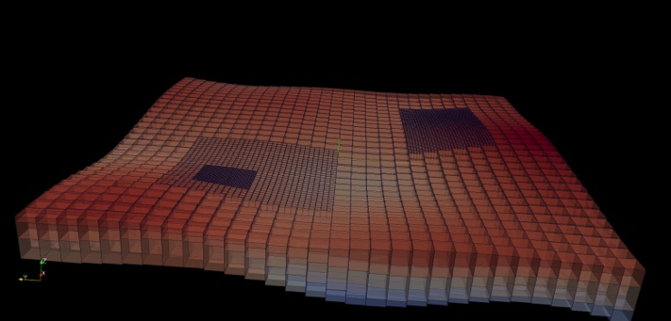
LGR Simulation
Simulation
Temporal Discretization
Simulation Name File
PARENT
BEGIN OPTIONS
END OPTIONS
BEGIN TIMING
TDIS6 mysim.tdis
END TIMING
BEGIN MODELS
GWF6 parent.nam PARENT
GWF6 c1.nam C1
GWF6 c2.nam C2
GWF6 gc.nam GC
END MODELS
BEGIN EXCHANGES
GWF6-GWF6 parent-c1.exg PARENT C1
GWF6-GWF6 parent-c2.exg PARENT C2
GWF6-GWF6 c1-gc.exg C1 GC
END EXCHANGES
BEGIN SOLUTIONGROUP 1
IMS6 mysolver.ims PARENT C1 C2 GC
END SOLUTIONGROUP
C1
C2
GC
Iterative Model Solution
PARENT-C1
PARENT-C2
C1-GC

Slide 26
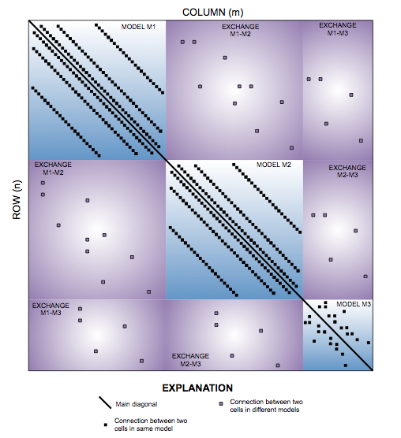
Matrix-Level Coupling
Simulation
Temporal Discretization
PARENT
C1
C2
GC
Iterative Model Solution
PARENT-C1
PARENT-C2
C1-GC
Notes:
Because our solver is unstructured and asymmetric, can handle Newton-Raphson, unstructured grids, ghost nodes, XT3D, dispersion tensors, etc…

Slide 27
Groundwater flow (gwf) model

Slide 28
GWF Model Highlights
Generalized control-volume finite-difference formulation
Regular MODFLOW grids
Unstructured grids
IDOMAIN capability
Full 3D anisotropy
Multiple stress package ”instances”
Water Mover
New input structure

Slide 29
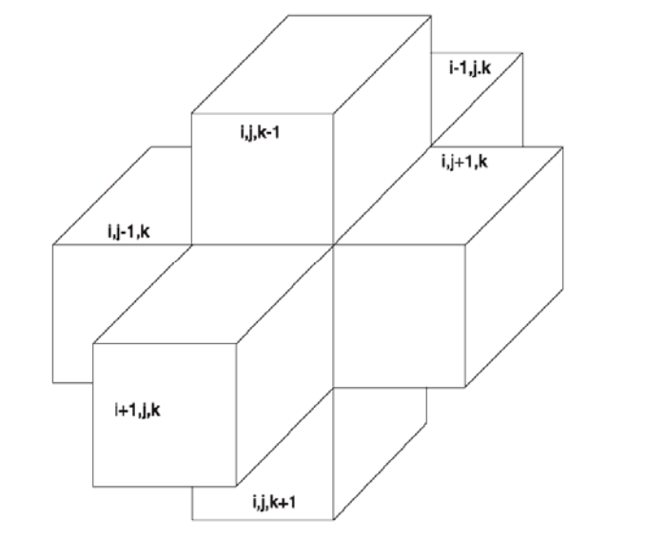
Finite-Difference Equation

Slide 30
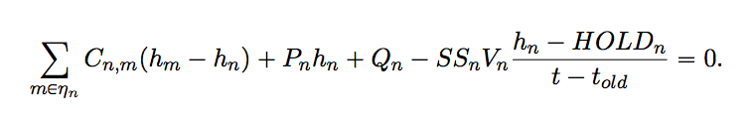
Generalized CVFD Equation

Slide 31
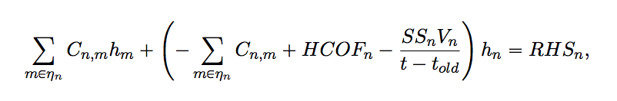
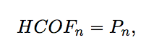
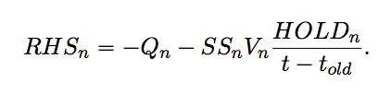
Rearranged for Solution

Slide 32
CVFD Accuracy Considerations
Line connecting cell centers bisects shared face at a right angle
Line connecting cell centers does not bisect shared face at a right angle

Slide 33
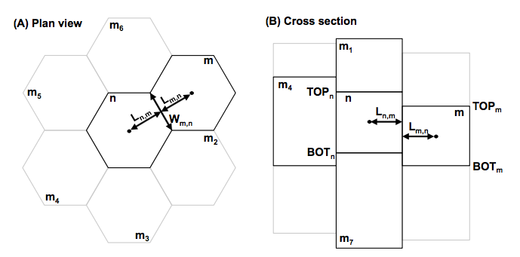
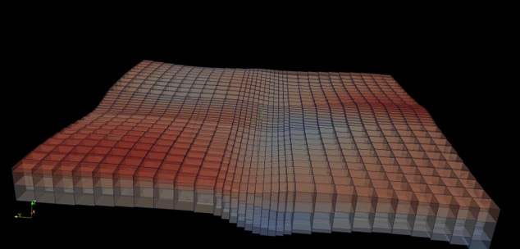
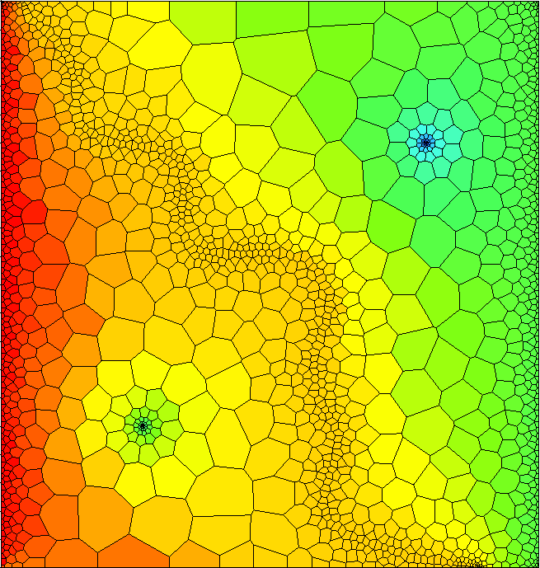
Spatial Discretization
Three ways to enter grid
DIS – regular MODFLOW grid
DISV – discretization by vertices
DISU – fully unstructured

Slide 34
Discretization (DIS) Package
“Regular MODFLOW grid”
Consists of layers, rows, and columns
Top and bottoms can have variable elevations

Slide 35
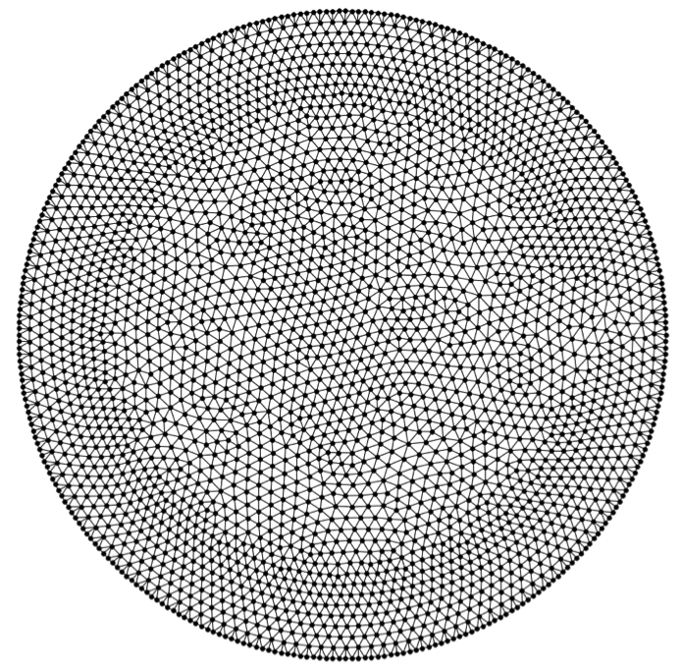
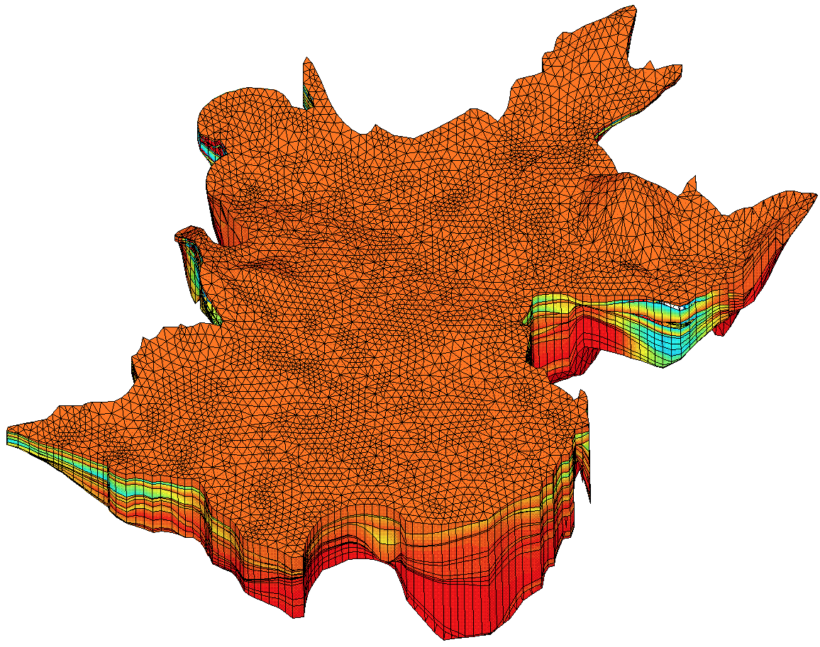
Discretization by Vertices (DISV)
Boundary fitted grids!
Allows unstructured grids to be constructed using common mesh generators
Layered

Slide 36
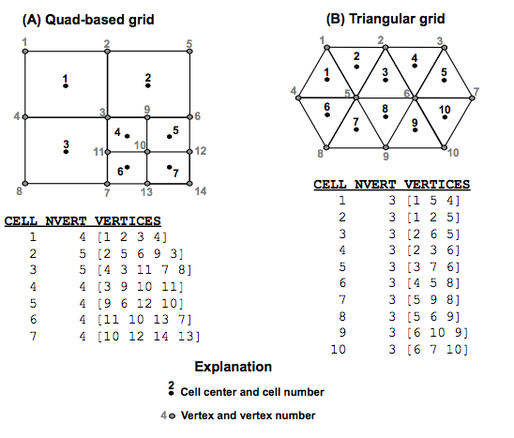
DISV (cont.)
User provides
List of x,y vertices
List of vertices for each cell
MODFLOW determines cell connectivity

Slide 37
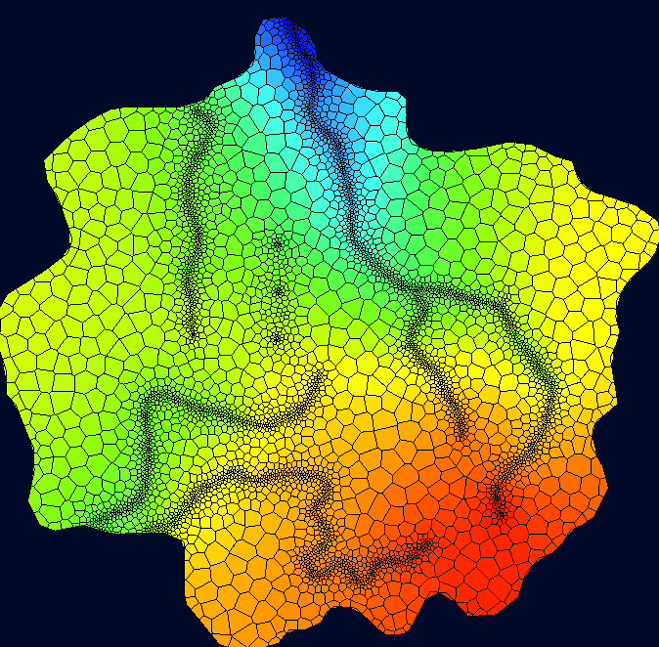
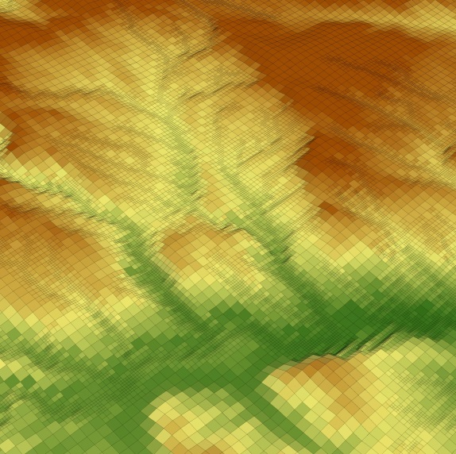
DISV (cont.)
Cells are referenced by (layer, cell number)
Not immune to CVFD accuracy considerations

Slide 38
Ghost-Node Correction (GNC) Package
standard finite volume formulation
ghost-node formulation
head at ghost node
optional formulation in MODFLOW
Notes:
Developed by Edwards, Mehl and Hill, etc.
Limitation of standard finite volume formulation: line connecting two nodes must intersect shared edge at a right angle.
Alpha parameters can be calculated to include effects of heterogeneity

Slide 39
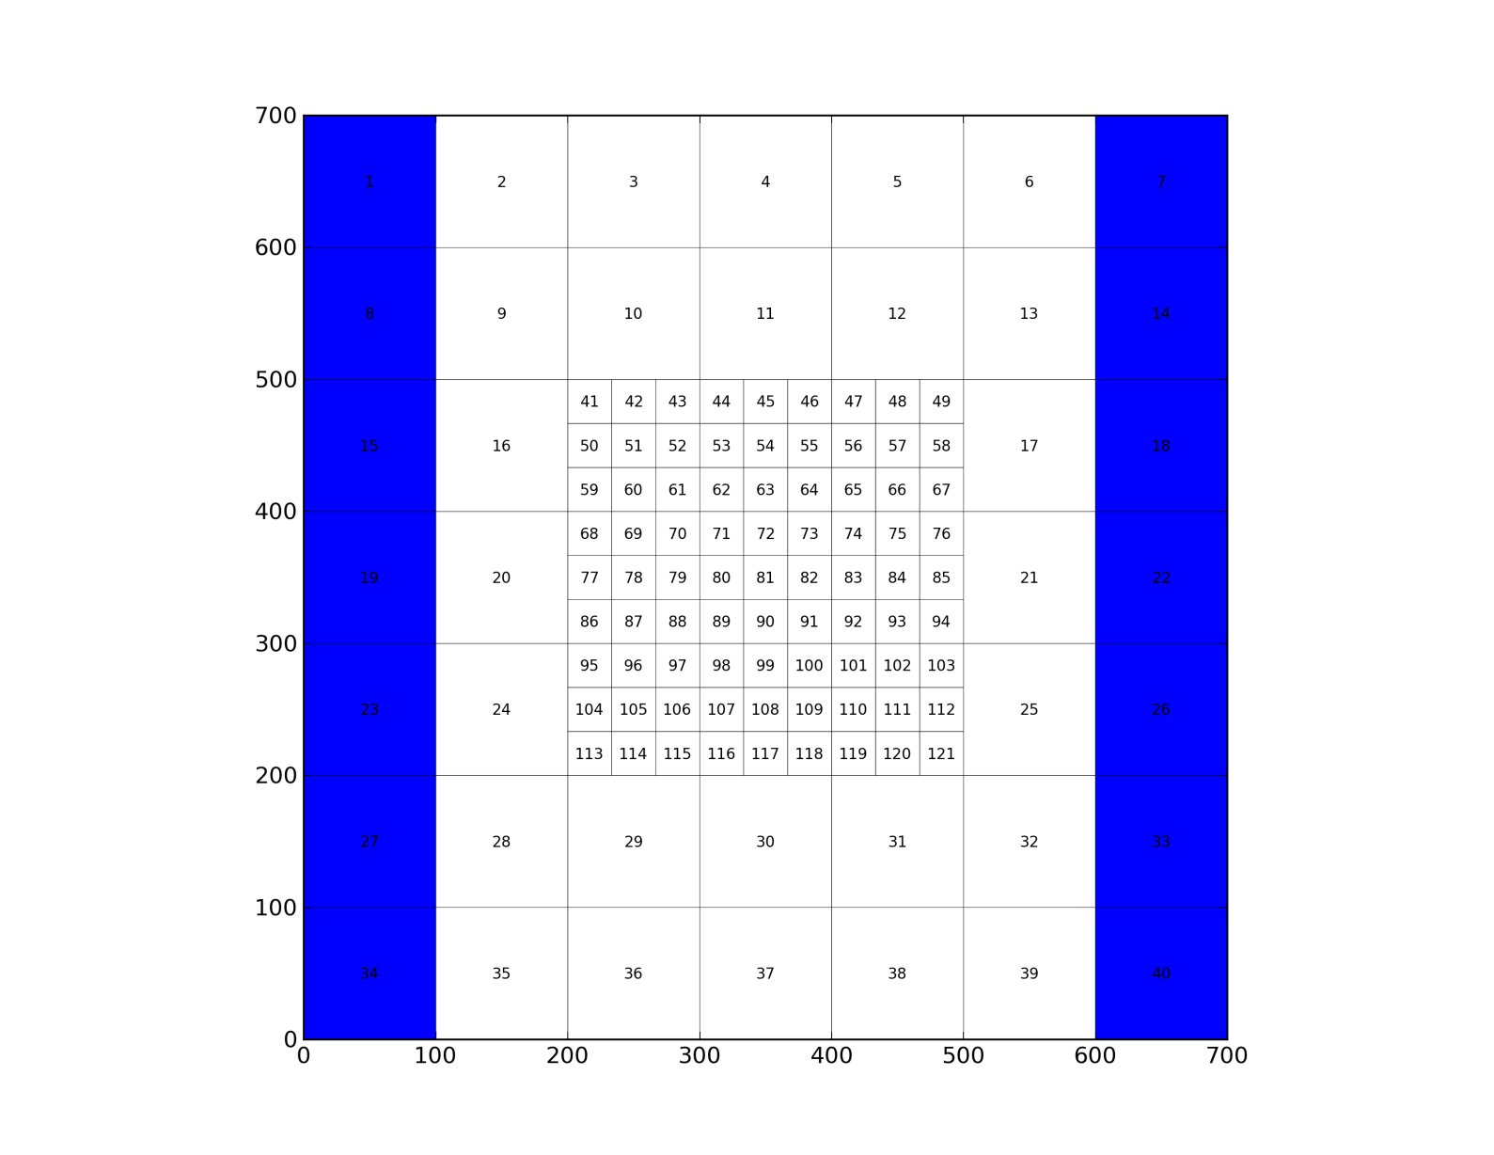
Ghost-Node Example

Slide 40
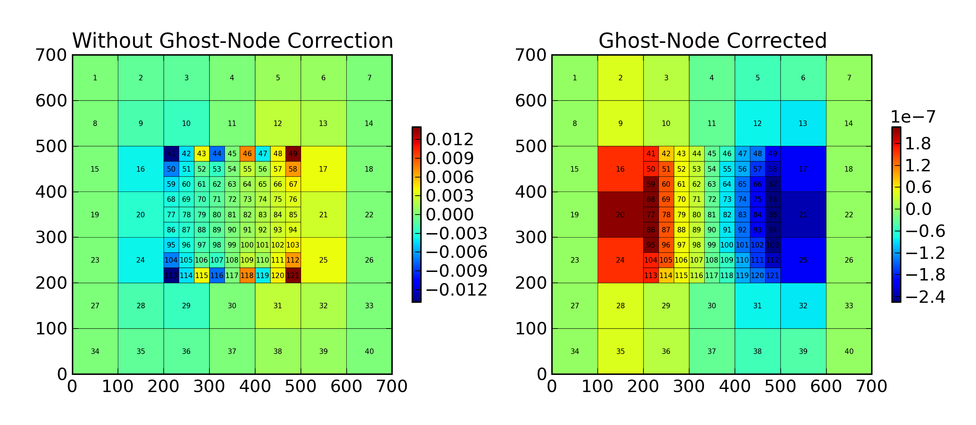
Simulation Errors

Slide 41
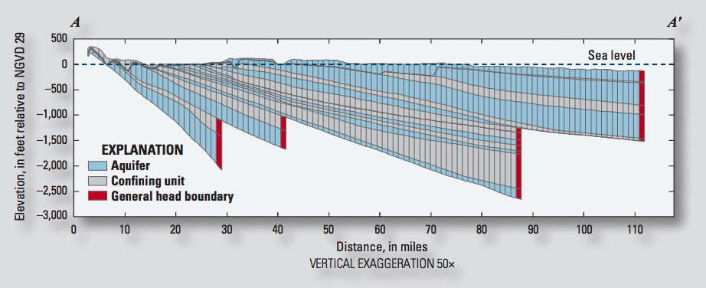
IDOMAIN Capability
Improve efficiency for models with large areas of inactive cells
Address MODFLOW limitations with discontinuous hydrogeologic layers

Slide 42
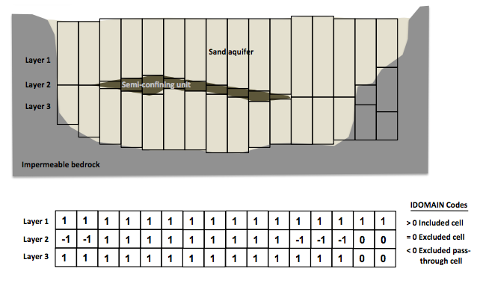
IDOMAIN Capability (cont.)
Permanently remove a cell from the simulation
Can be used with DIS and DISV
Optionally connect overlying and underlying cells

Slide 43
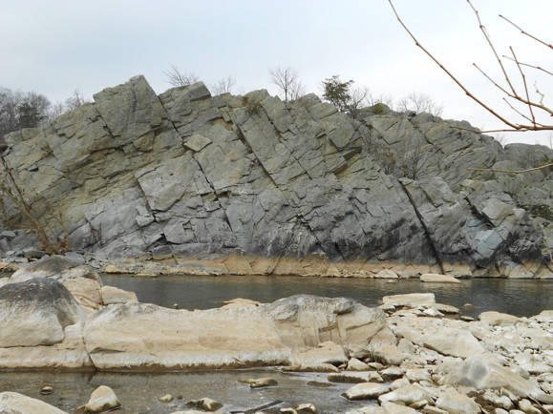
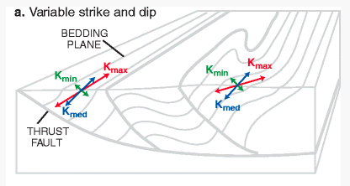
Representation of Anisotropy
Representation of full 3D anisotropy may be required for some problems (fractured aquifers, structurally deformed aquifers)
Some capabilities available (LVDA, SUTRA), but needed generalized CVFD method

Slide 44
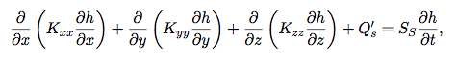
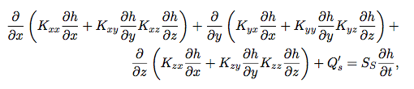
Groundwater Flow Equation
Traditional MODFLOW
Generalized 3D Anisotropic Flow

Slide 45
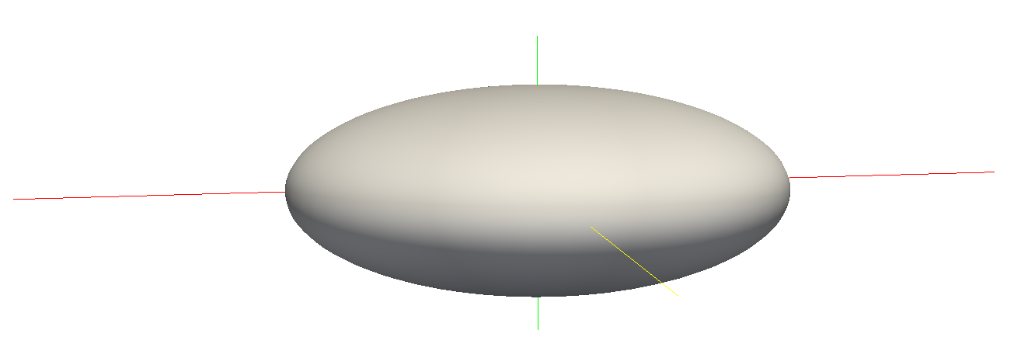
Hydraulic Conductivity Ellipsoid
Defined by three user-provided values on a cell by cell basis
For unrotated case,
K11 = Kx
K22 = Ky
K33 = Kz
K11
K22
K33

Slide 46
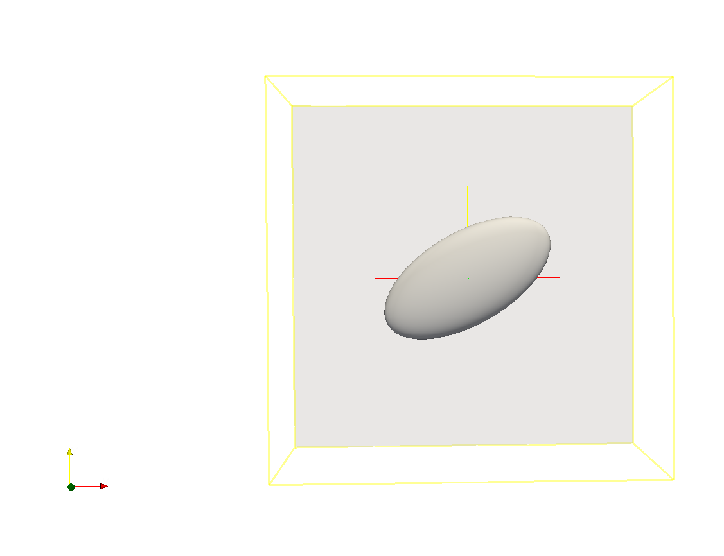
Ellipsoid Rotation
Users can optionally provide ANGLE1, ANGLE2, and ANGLE3 on a cell by cell basis
ANGLE1 is counter-clockwise rotation in the x, y plane

Slide 47

Ellipsoid Rotation (cont.)
All three angles can be specified to represent ellipsoid orientation

Slide 48



Effective Conductivity Approach
Large errors for certain ellipsoid configurations
Approximate, but relatively fast
Simple to implement

Slide 49




XT3D Approach
General and robust handling of anisotropy
Computationally expensive
Improves flow solution for certain grid types
Is being used for dispersion

Slide 50

All GWF Packages

Slide 51

Multiple Package of Same Type

Slide 52

Water Mover (MVR) Package
Need trackable way to transfer available water from one package to another
Previously hardwired (e.g., LAK <> SFR, DRT)
MODFLOW 6 has generic capability to move water from a “provider” to a “receiver”
Provider packages:
WEL, DRN, RIV, GHB
MAW, SFR, LAK, UZF
Receiver packages:
MAW, SFR, LAK, UZF
Notes:
WEL: available water is pumping rate
DRN: QA is groundwater flow into the drain
RIV: QA is groundwater flow into the river
GHB: QA is groundwater flow into the GHB
MAW: QA is the actual rate of pumped water
SFR: QA is the outflow for the specified reach
LAK: QA is the outflow at a lake outlet
UZF: QA is the rejected infiltration

Slide 53
Under development

Slide 54
Current Efforts
Subsidence Package
XT3D across models
MPI parallelization
Generalized particle tracking
Groundwater Transport GWT Model
Unstructured grids
XT3D for dispersion
Transport through cells that are “dry”
Variable Density Groundwater Flow and Transport
Unstructured grids
Support for Newton (hydraulic head formulation)
Linear Network Flow (LNF) Model

Slide 55
Henry-Like Wetting/Drying Problem
Seawater Tidal Boundary
Freswhwater Inflow Boundary
Notes:
Velocity-based dispersion coefficients

Slide 56

MODFLOW 6 Animation
Notes:
10 seconds to run this.

